Slide 1

Accelerated discovery of inorganic thermoelectric materials
8 Nov 2024
KRICT ChemDX Hackathon

Slide 2
Background

Slide 3
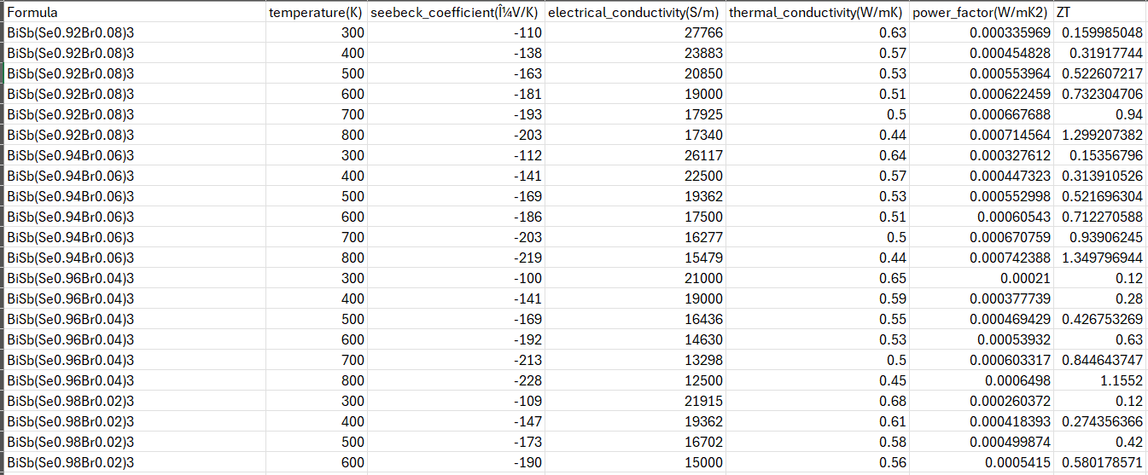
LitDX - Thermoelectrics

Slide 4
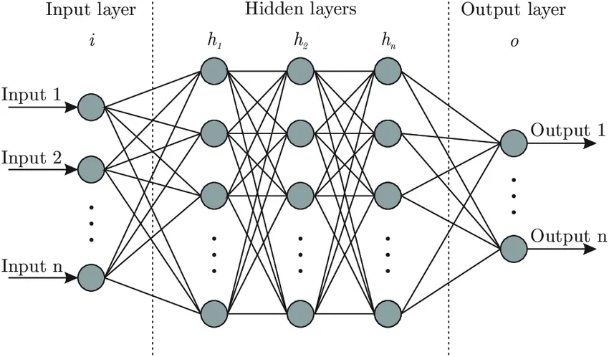
Model training
Composition
Stochiometric attributes
Elemental property statistics
Electronic structure attributes
Ionic compound attributes
Temperature
Outputs
Seebeck coefficient S
Electrical conductivity σ
Thermal conductivty κ
+
L Ward et al, npj Comp Mat, 2016, 10.1038/npjcompumats.2016.28

Slide 5











Model training
Single-task
Multi-task
$$x$$
$$x$$
ML
$$\text{ML}$$
$$\text{ML}$$
$$\text{ML}$$
$$σ$$
$$s$$
$$k$$
$$σ$$
$$s$$
$$k$$

Slide 6
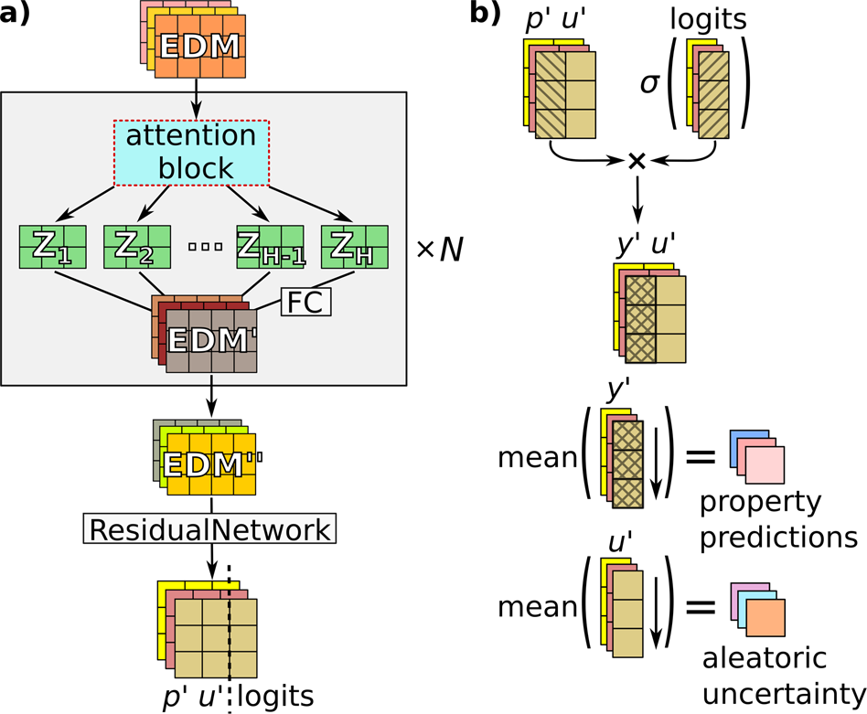
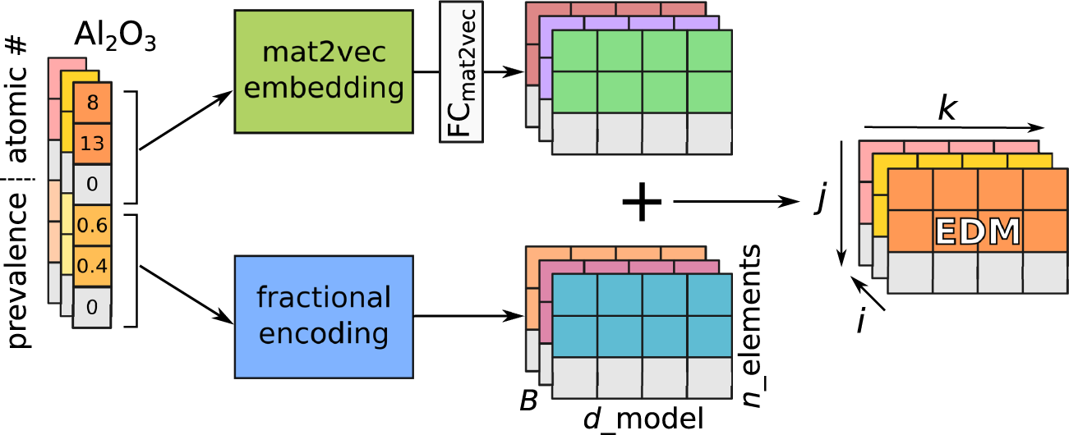
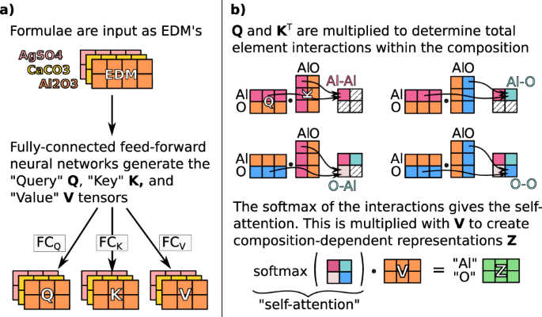
Model training
A Yang et al, npj Comp Mat, 2021, 10.1038/s41524-021-00545-1

Slide 7
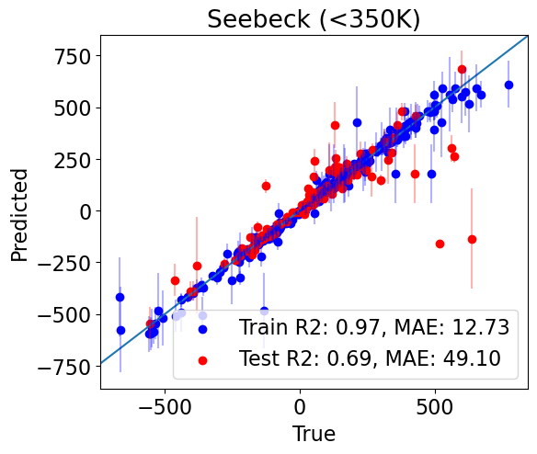
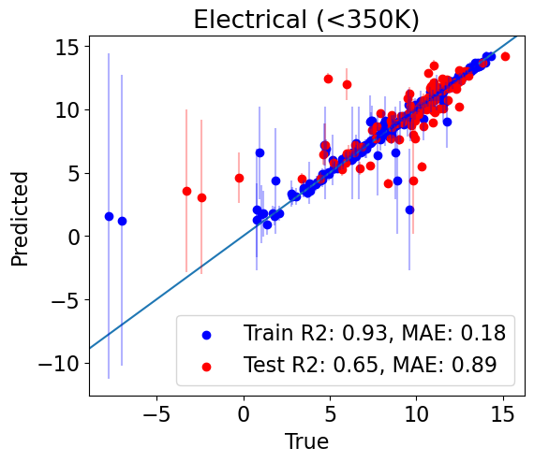
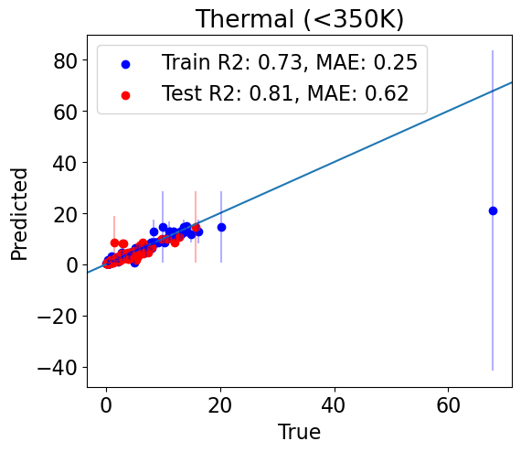
Model training
LiCoO2
TiS2

Slide 8
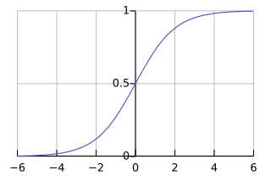
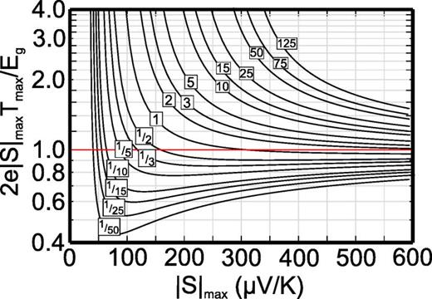
ZT-T curve fitting algorithm
Physics informed curve fitting using:
Melting point of the compounds (future)
Goldsmidt-Sharp limit ($E_{g}=2eS_{max}T_{max}$)
Z Gibbs et al, App Phys Lett, 2015, 10.1063/1.4905922

Slide 9
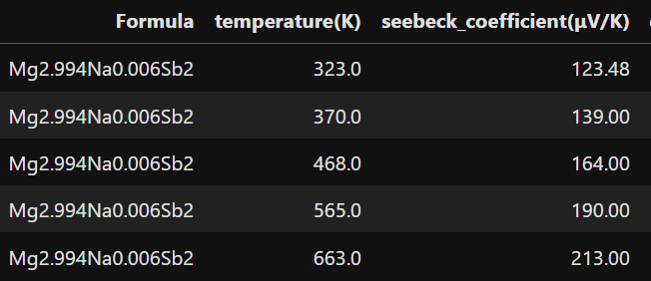
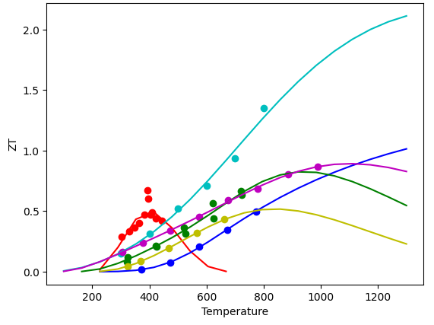
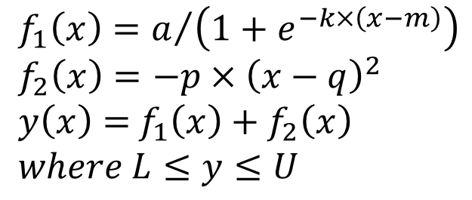
ZT-T curve fitting algorithm
$$f_{1}\left(x\right)=a/{\left(1+e^{−k×\left(x−m\right)}\right)}$$
$$f_{2}\left(x\right)=−p×{\left(x−q\right)}^{2}$$
$y\left(x\right)=$ $f_{1}\left(x\right)+f_{2}\left(x\right)$
$$where L≤y≤U$$
T_{max} with margin

Slide 10
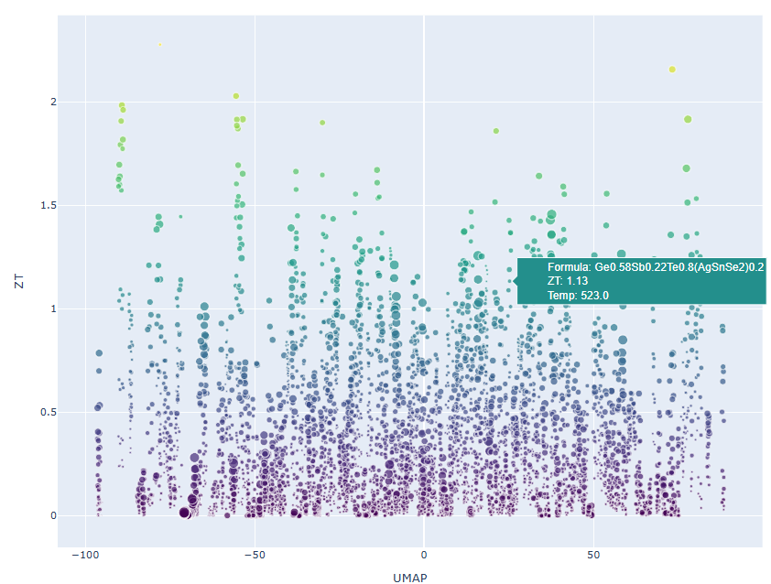
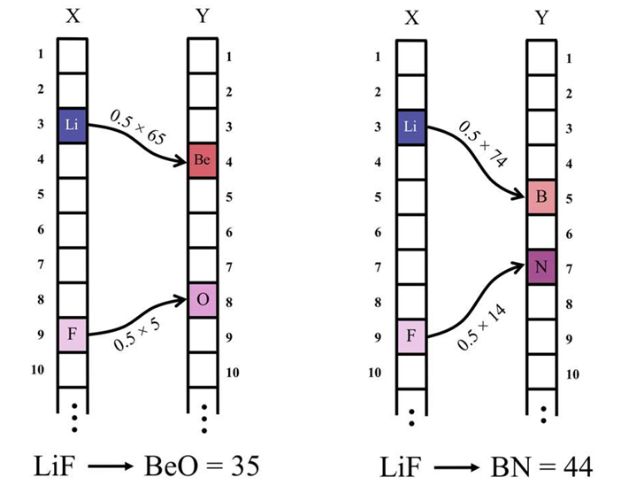
Visualization via Elemental Movers Distance (ElMD
C Hargreaves et al, Chem Mater, 2020, 10.1021/acs.chemmater.0c03381

Slide 11
Active learning workflow
1. Dataset of TE materials
2. Multi-task ML model
3. Compute and extrapolate ZT-T curve
4. Sample/optimize chemical similarity and ZT at target T

Slide 12
Contributions
ML property prediction for S, σ and κ
ZT-T curve fitting algorithm with informed physics
Visualization tool for chemical space
Workflow for sampling/optimization of TEs

Slide 13
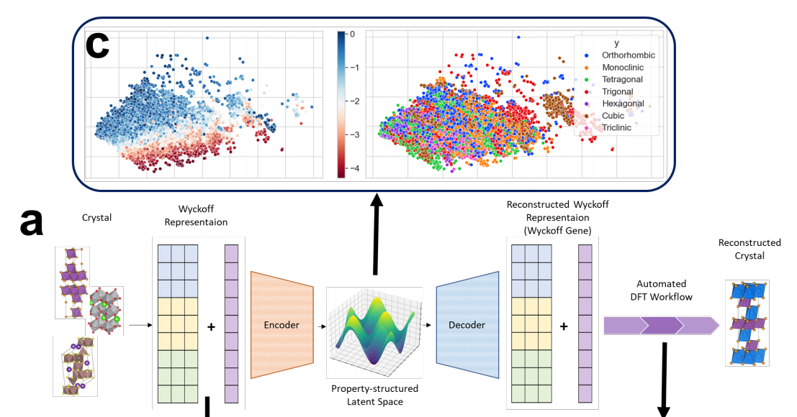
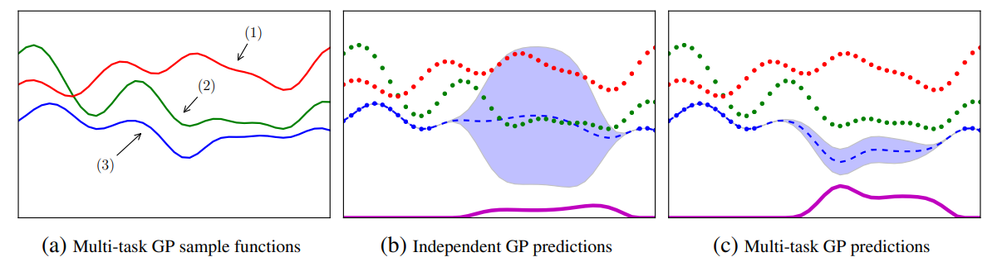
Future work
Wang et al. npj Comput Mater 7, 77 (2021)
Zhu et. al. Matter 7, 10, 3469-3488 (2024)

Slide 14
Thank you!

